Slide 1
Linked-Lists
Slides by Varick and Ashley Erickson
© Varick and Ashley Erickson

Slide 2
Why linked lists
Linked lists can help us do more stuff with data!
We can insert stuff into the middle of a list
We can delete stuff from the middle of a list
We can easily add stuff to the front or back of a list
Linked lists live in dynamic memory, so the size can be easily adjusted

Slide 3

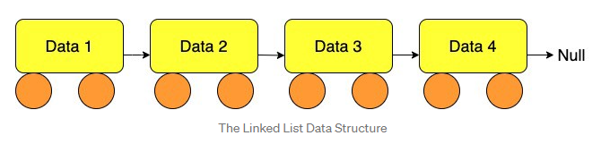
Linked list organization
head
nullptr
list
head
Node 1
Node 2
Node 3
A Linked list contains 0 or more nodes:
The linked list’s head to point to first node
Last node points to nullptr(address 0)

Slide 4
Node organization
In C++, nodes are implemented as structs or classes
A node contains:
data: one or more data fields – may be organized as structure, object, etc.
a pointer (often called “next”) that can point to another node
struct ListNode
{
int data;
ListNode *next;
};
next
data

Slide 5
Process for building a linked list
First, set up the head of a linked list with nodes. Then, after we get the head, we can add more nodes.
Declare a struct or object which you want to use for each item or node
Declare a pointer variable that points to the head of the linked list.
Use the new operator to make head point to a new node. This is the first node of the list.
Use the arrow operator to update the values and pointers in each node.
Keep adding nodes using the new operator or by rearranging the pointers connecting each node.
Make sure the last node points to nullptr.

Slide 6

1. Declaring a struct or object for the Node
Declare a struct or object for the node:
struct ListNode
{
int data;
ListNode *next;
};
No memory is allocated at this time. All you are doing is saying what each node looks like.
Make sure your struct or object includes a pointer so that you can connect to the next node.

Slide 7
2. Declaring a pointer which points to the head of the Linked List
Use your node data type to define a pointer called head for the beginning of the list:
ListNode *head = nullptr;
People very often call this pointer “head”
head pointer initialized to nullptr to indicate an empty list
head
NULL
head

Slide 8
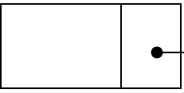
3. Use new operator to create the first node
Use new operator to create dynamic variable for the first node
head = new ListNode;
Note: There is no “index” for each node.
Each node must be accessed by its pointer.
head
head = new ListNode;
head
*next
NULL
data
struct ListNode
{
int data;
ListNode *next;
};

Slide 9
4. Assign values to the new node using the arrow operator ->
The arrow operator combines the actions of the dereferencing operator (*) and the dot operator (. ) .
head->data = 23;
head->next = nullptr;
The arrow operator is the same as writing
(*head).data = 23;
(*head).next = nullptr;
head
data
*next
23
NULL
struct ListNode
{
int data;
ListNode *next;
};

Slide 10
5. Keep adding more nodes
Example: Adding a second node to the end (with same ListNode struct):
head->next = new ListNode; //make first node’s pointer //point to a new second node
head->next->data = 24; //set data of second node //to 24
head->next->next = nullptr; //make second node point //to NULL
head
data
*next
*next
data
23
head
*next
*next
data
data
23
24
head
data
*next
data
*next
23
24
nullptr

Slide 11
5. Keep adding more nodes (to beginning)
Example: Adding a second node to the beginning (with same ListNode struct):
ListNode* newHead; // Create a pointer called newHead
newHead = new ListNode; // Allocate space for new node
newHead->next = head; // Link the newHead to old head
head
*next
newHead
*next
23
NULL
newHead->next = head;
newHead
*next
*next
23
NULL

Slide 12
5. Add more Nodes (to beginning, continued)
(adding new node to the beginning, continued)
newHead->data = 24; // set value in new node to 24
head = newHead; // rename newHead as the head
newHead
*next
*next
24
23
NULL

Slide 13
6. Make sure the last node points to nullptr
The last item in the Linked List MUST point to NULL or nullptr.
Otherwise you won’t know where the end is.
head
*next
23
NULL

Slide 14
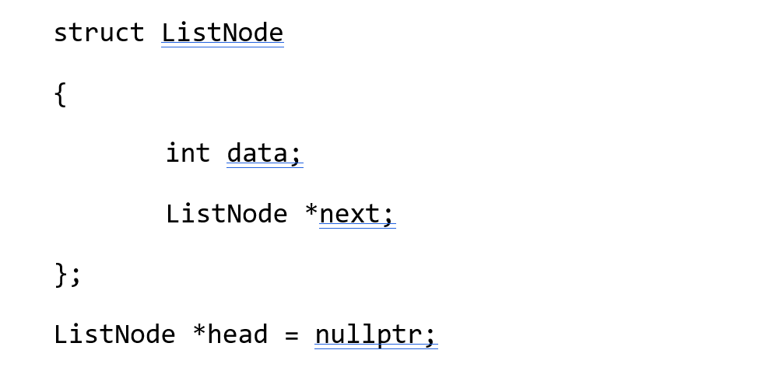
Memory Diagram Practice
Draw what the code produces and explain your answer:

Slide 15
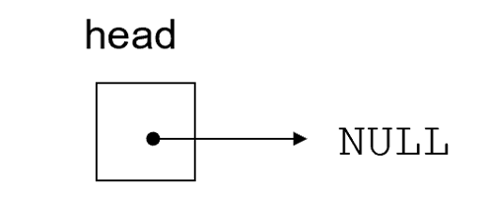
Memory Diagram Practice
Suppose we have the following:
Then the following code is run:
head = new ListNode;
head->data = 12;
head->next = nullptr;

Slide 16
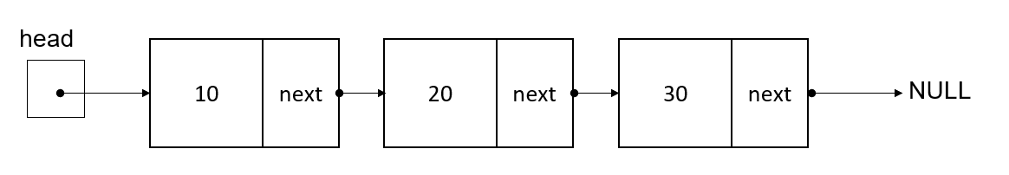
Memory Diagram Practice
Suppose we have the following:
Then, we run the following lines of code.
ListNode* nextNode;
nextNode = new ListNode;
nextNode->data = 99;
nextNode->next = nullptr;
head->next->next->next = nextNode;
cout << head->next->next->next->data;

Slide 17
Memory Diagram Practice
We have this linked list of the type ListNode as shown here
Write the code which will add a node containing the number 99 to the end of the list

Slide 18
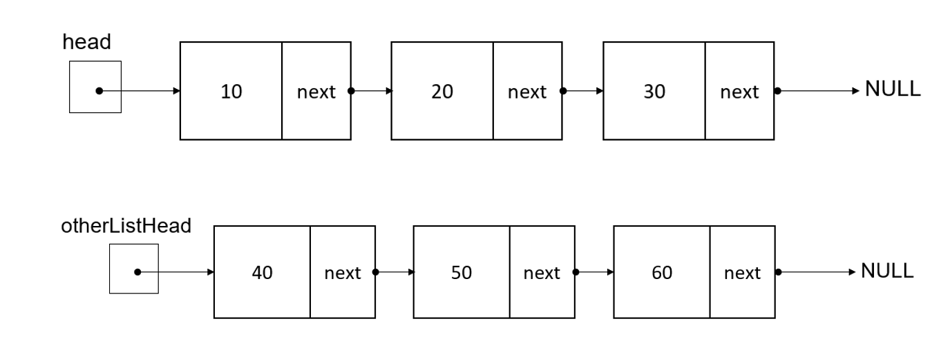
Memory Diagram Practice
Suppose we have the two linked lists shown below.
Write the code which will attach the lists together like below?

Slide 19
Example: Inserting nodes
Suppose we have these two nodes. We want to insert the head linked list into otherListHead’s linked list, between nodes 40 and 50.
Let’s look at this step by step.
insert

Slide 20
Example: Inserting nodes
Identify the location where you want to insert the new nodes
Connect the pointer from the new node to the list to create a link. What code should we write to do this?
Insert here
Stuff we want to insert

Slide 21
Example: Inserting nodes
2. Connect the pointer from the new node to the list to create a link.
head->next->next->next = otherListHead->next;
//makes pointer at head’s 3rd node point to the insertion point
//(the location which otherListHead->next points at)

Slide 22
Example: Inserting nodes
Now we need to connect otherListHead’s first node to the first node of head:
What code should we write to connect otherListHead’s node to head?

Slide 23
Example: Inserting nodes
Now we need to connect otherListHead’s first node to the first node of head:
Connect otherListHead to head:
otherListHead->next = head;
//makes otherListHead’s first node point to the first node of the
//nodes to insert

Slide 24
Example: Inserting nodes
We now have the below inserted linked list!
4. Now we need to update the head pointer, since the head pointer has changed from head to otherListHead. What code should we write?

Slide 25
Example: Inserting nodes
All finished!
head
head = otherListHead;
//updates the location of the head pointer to be the new
//beginning of the linked list, at otherListHead.

Slide 26
Codey sense question
We just discussed that to insert, you need to
add a link from the new node to the list, and
then add a link from the list to the new node.
What would happen if we reversed these steps like shown below?
A: Reversing the steps does not matter. We would get the same result.
B: Reversing the steps will produce the same result with less code.
C: Reversing the steps will produce the same result, but with more code needed.
D: Reversing the steps will produce a different result. Some nodes will be orphaned and we will produce a memory leak.
1. Add link from list to new node
2. Add link from new node to list

Slide 27
Codey sense question
Reversing the steps will produce a different result. Some nodes will be orphaned and we will produce a memory leak.
Add a link from list to new node
2. Add a link from new node back to the list
These nodes become orphaned because we just disconnected from them from their head node!!! There is nothing storing the memory address of node 50.
There is nothing left to connect back to, because we lost the memory address of these nodes!

Slide 28
Key takeaway: inserting nodes
To insert, you need to
add a link from the new node to the list, and
then add a link from the list to the new node.
CAUTION!!!! when changing the pointers, be careful not to “orphan” any nodes or lose the head! Be sure to maintain some connection to your head and all nodes at all times. Otherwise, your program will create memory leaks and lost nodes.

Slide 29
Stepping through a linked list
Recall, the -> operator allows us to step through a linked list.
If next is the name of our pointer, we can use ->next to advance to the next item.
Examples:
cout << head->data; // returns 10
cout << head->next->data; // returns 20
cout << head->next->next->next; // returns NULL
cout << head->next->next->next->data; // returns nullpointer exception
head = head->next // makes head pointer point to the
// next item in the list

Slide 30
Quick question
Suppose we have the below linked list, with myPointer pointing to the second node. Which of the following lines of code will advance the pointer “myPointer” to the next node?
A: myPointer->next;
B: myPointer = next;
C: myPointer = next+1;
D: myPointer++;
E: myPointer = myPointer->next;
myPointer

Slide 31
Things to be aware of when stepping
You can only travel one direction in a (singly) linked list. You cannot use -> next to go backwards.
There are special types of linked lists (doubly linked lists) where you have two pointers per node, allowing travel in both directions.
Our book likes to name the linked list pointers “link” but programmers also commonly name the pointers “next”.

Slide 32
Questions before we continue?
Next: how to search in a linked list

Slide 33
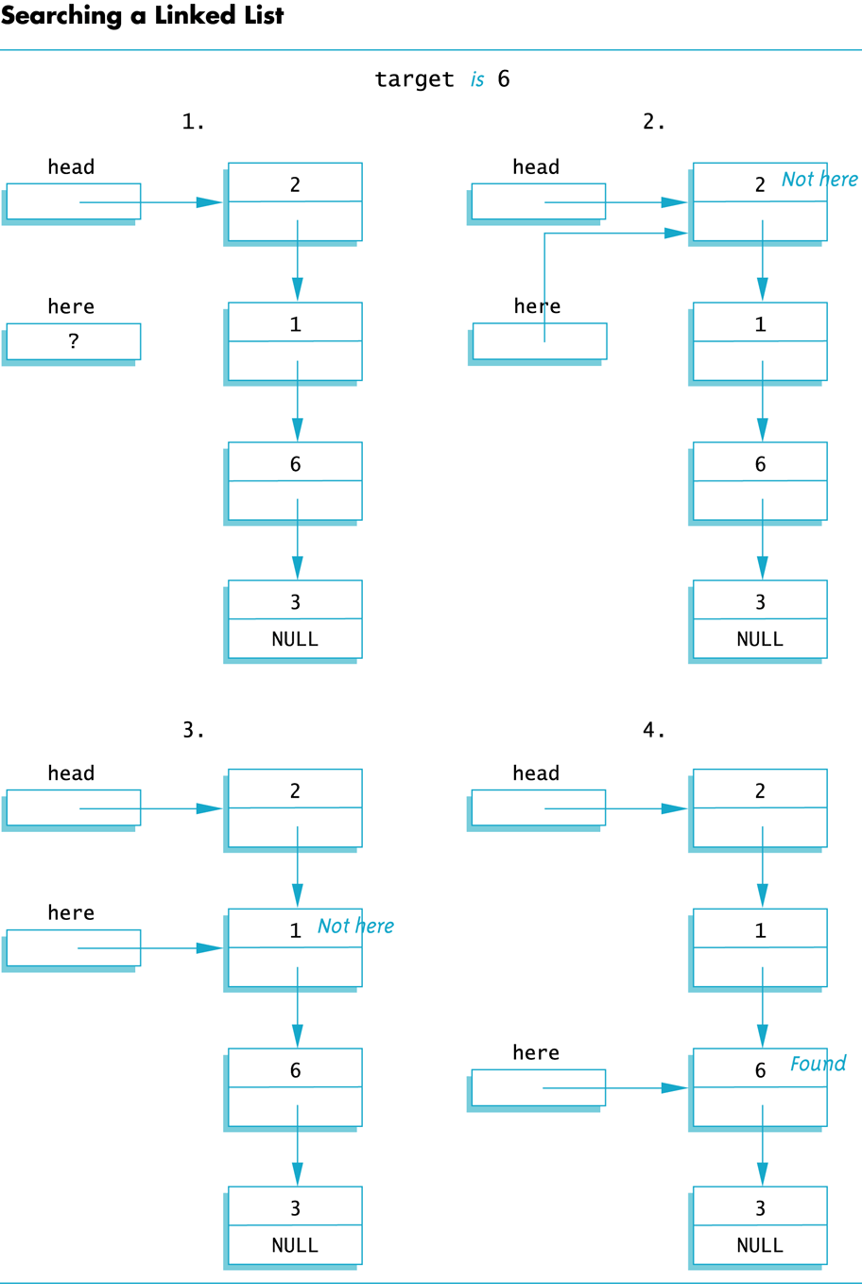
How to search in a linked list: pseudocode
Declare a pointer (below, it is called “here”) to point to a node.
Set here to point to the head initially
Check whether the node we are pointing to contains the desired value
If the pointer’s value is the desired value, return the pointer.
If not, move to the next node of the linked list (here = here->next)
Otherwise, if we search all the way until we reach null, the desired value must not be present in the Linked List.

Slide 34
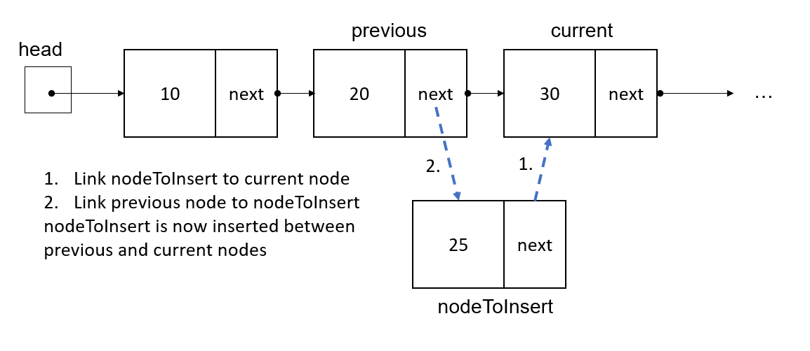
Searching and inserting
If you need to search and then insert something into a linked list, you should declare two pointers to help you search.
One pointer to point at the current location
One pointer to point at the previous location
Declare pointers to point at the current and previous node.

Slide 35
Searching and inserting
You can use a while loop to step through the linked list until the current and previous pointers find the desired location.
Then, you can use current and previous pointers to help insert the node you want to insert:
ListNode* prev = nullptr;
ListNode* curr = head;
while (curr != nullptr)
{
if (curr->data == desiredValue)
break;
prev = curr;
curr = curr->next;
}
nodeToInsert->next = current;
prev->next = nodeToInsert;

Slide 36
Another Codey Sense question
Which of the following statements about these loops is true?
A
B
ListNode* prev = nullptr;
ListNode* curr = head;
while (curr != nullptr)
{
if (curr->data == desiredValue)
break;
prev = curr; curr = curr->next;
}
nodeToInsert->next = current;
prev->next = nodeToInsert;
ListNode* prev = nullptr;
ListNode* curr = head;
while (curr->data != desiredValue)
{
prev = curr;
curr = curr->next;
}
nodeToInsert->next = current;
prev->next = nodeToInsert;
A: Loop A is less efficient since it requires more code
B: Loop B could create an infinite loop
C: Loop B could cause a runtime exception if the desired value is not present in the list
D: Both of these loops are equivalent

Slide 37
Any questions before we continue?
Next topic: linked list good practices
Searching a linked list

Slide 38
Linked List good practices
Make sure you check for an empty list before manipulating it.
You should always keep one pointer variable pointing to the head of the linked list. This pointer can be used as the linked list argument in functions and to help you access the data.
Be careful not to lose your head node. If you overwrite your pointer which points to the head node, you can lose your ability to access that node. You could lose your ability to access your memory, and also tie up memory that cannot be used for other parts of your program.

Slide 39
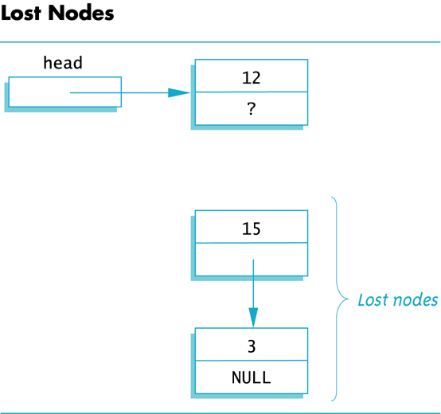
Memory leaks and lost nodes
Lost nodes can create memory leaks.
Memory leaks can cause the operating system to crash when it runs out of memory.
To avoid memory leaks, always keep some pointer pointing to the head of the linked list.

Slide 40
Linked List Operations to know
Basic operations:
append a node to the end of the list
insert a node within the list
traverse the linked list
delete a node
delete/destroy the list

Slide 41
Overview: Inserting a node into a linked list
To insert, you need to
add a link from the new node to the list, and
then add a link from the list to the new node.
CAUTION!!!! when changing the pointers, be careful not to “orphan” any nodes or lose the head! Be sure to maintain some connection to your head and all nodes at all times. Otherwise, your program will create memory leaks and lost nodes.

Slide 42
Example: Inserting nodes
Suppose we have these two nodes. We want to insert the head linked list into otherListHead’s linked list, between nodes 40 and 50.
Let’s look at this step by step.
insert

Slide 43
Example: Inserting nodes
Identify the location where you want to insert the new nodes
Connect the pointer from the new node to the list to create a link. What code should we write to do this?
Insert here
Stuff we want to insert

Slide 44
Example: Inserting nodes
2. Connect the pointer from the new node to the list to create a link.
head->next->next->next = otherListHead->next;
//makes pointer at head’s 3rd node point to the insertion point
//(the location which otherListHead->next points at)

Slide 45
Example: Inserting nodes
Now we need to connect otherListHead’s first node to the first node of head:
What code should we write to connect otherListHead’s node to head?

Slide 46
Example: Inserting nodes
Now we need to connect otherListHead’s first node to the first node of head:
Connect otherListHead to head:
otherListHead->next = head;
// makes otherListHead’s first node point to the first node of the
// nodes to insert

Slide 47
Example: Inserting nodes
We now have the below inserted linked list!
4. Now we need to update the head pointer, since the head pointer has changed from head to otherListHead. What code should we write?

Slide 48
Example: Inserting nodes
All finished!
head
head = otherListHead;
//updates the location of the head pointer to be the new
//beginning of the linked list, at otherListHead.

Slide 49
Codey sense question
We just discussed that to insert, you need to
add a link from the new node to the list, and
then add a link from the list to the new node.
What would happen if we reversed these steps like shown below?
A: Reversing the steps does not matter. We would get the same result.
B: Reversing the steps will produce the same result with less code.
C: Reversing the steps will produce the same result, but with more code needed.
D: Reversing the steps will produce a different result. Some nodes will be orphaned and we will produce a memory leak.
1. Add link from list to new node
2. Add link from new node to list

Slide 50
Codey sense question
Reversing the steps will produce a different result. Some nodes will be orphaned and we will produce a memory leak.
Add a link from list to new node
2. Add a link from new node back to the list
These nodes become orphaned because we just disconnected from them from their head node!!! There is nothing storing the memory address of node 50.
There is nothing left to connect back to, because we lost the memory address of these nodes!

Slide 51
Key takeaway: inserting nodes
To insert, you need to
add a link from the new node to the list, and
then add a link from the list to the new node.
CAUTION!!!! when changing the pointers, be careful not to “orphan” any nodes or lose the head! Be sure to maintain some connection to your head and all nodes at all times. Otherwise, your program will create memory leaks and lost nodes.

Slide 52
Stepping through a linked list
Recall, the -> operator allows us to step through a linked list.
If next is the name of our pointer, we can use ->next to advance to the next item.
Examples:
cout << head->data; //returns 10
cout << head->next->data; //returns 20
cout << head->next->next->next; //returns NULL
cout << head->next->next->next->data; //returns nullpointer exception
head = head->next //makes head pointer point to the
//next item in the list

Slide 53
Quick question
Suppose we have the below linked list, with myPointer pointing to the second node. Which of the following lines of code will advance the pointer “myPointer” to the next node?
A: myPointer->next;
B: myPointer = next;
C: myPointer = next+1;
D: myPointer++;
E: myPointer = myPointer->next;
myPointer

Slide 54
Things to be aware of when stepping
You can only travel one direction in a (singly) linked list. You cannot use -> next to go backwards.
There are special types of linked lists (doubly linked lists) where you have two pointers per node, allowing travel in both directions.
Our book likes to name the linked list pointers “link” but programmers also commonly name the pointers “next”.

Slide 55
Questions before we continue?
Next: how to search in a linked list

Slide 56
How to search in a linked list: pseudocode
Declare a pointer (below, it is called “here”) to point to a node.
Set here to point to the head initially
Check whether the node we are pointing to contains the desired value
If the pointer’s value is the desired value, return the pointer.
If not, move to the next node of the linked list (here = here->next)
Otherwise, if we search all the way until we reach null, the desired value must not be present in the Linked List.

Slide 57
Searching and inserting
If you need to search and then insert something into a linked list, you should declare two pointers to help you search.
One pointer to point at the current location
One pointer to point at the previous location
Declare pointers to point at the current and previous node.

Slide 58
More Hints Searching and inserting
You can use a while loop to step through the linked list until the current and previous pointers find the desired location.
Then, you can use current and previous pointers to help insert the node you want to insert:
ListNode* prev = nullptr;
ListNode* curr = head;
while (curr != nullptr)
{
if (curr->data == desiredValue)
break;
prev = curr;
curr = curr->next;
}
nodeToInsert->next = current;
prev->next = nodeToInsert;

Slide 59
Any questions before we continue?
How to use linked lists with classes, constructors and destructors
More demos

Slide 60
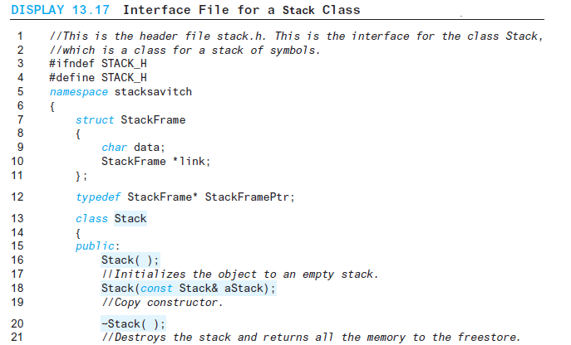
Making constructors
Recall, you can use a class to make nodes for a linked list or other data structure
You can declare constructors to initialize objects for nodes.
It’s a good idea to initialize pointers to NULL initially and initialize data in your object to a known value

Slide 61
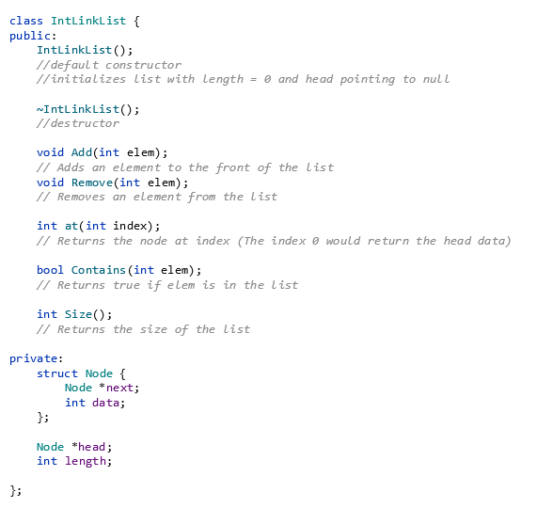
Deleting items and Destructors
Destructors are special member functions used to delete objects from a class.
You put a ~ in front of the class name to create a destructor.

Slide 62
Deleting items and Destructors
Destructors allow us to delete linked lists and nodes when we are finished.
If we do not delete our linked lists, we could run out of memory and cause our computer to crash.
It’s a good practice to always include destructors when using linked lists so that you can clean up your memory when you are finished using it.

Slide 63
Another way to define a destructor
You can also make a destructor using a loop to delete the items in the linked list.
This code will read each item of the linked list, starting with the head and ending with null. This code changes head to be the next value in the list, and then deletes the current value.
Once we reach null, all nodes will be deleted.
MyLinkedList::~MyLinkedList()
{
while (head != nullptr)
{
Node* oldHead = head;
head = head->next;
delete oldHead;
}
}

Slide 64
Important notes about destructors
Destructors must be declared and defined by the programmer in order to actually delete nodes.
Like the default constructor, the compiler will automatically create a destructor for you if you forget, but the destructor will be empty. It will not do anything unless we define it.

Slide 65
Any questions before we continue?
Time permitting: intro to data structures
examples of linked lists, stacks and queues

Slide 66
Making data structures
Linked lists are not the only kind of data structure we can make with classes and nodes.
Node-based structures can create many kinds of data structures

